Slide 1
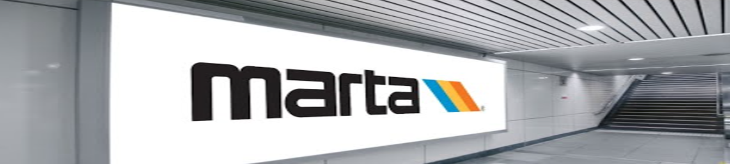
Vine City Station Crowd Control and Metering Challenge
Rider’s Advisory Council Meeting: 4 March 2026

Slide 2
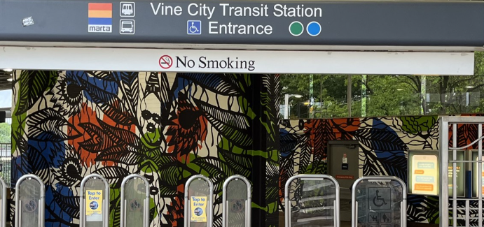

PURPOSE
To develop a solution to address crowd control and metering at the Vine City Station during a major event.

Slide 3
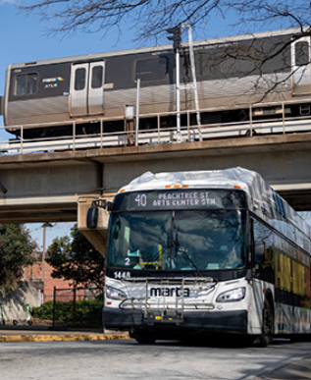
AGENDA
Meet the Team
Passenger Flow
Safety
Communication
Staffing
Overall Customer Experience
Summary
Questions

Slide 4






MEET THE TEAM
Erin
Sofia
Viola
Sade
MARTA Vine City Warriors
Kirk
Malachi

Slide 5
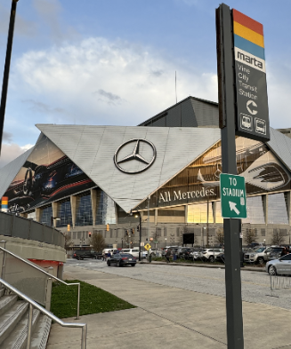
PASSENGER FLOW
Staff Encouraging Tap to Pay
2-Way Flow at Pedestrian Bridge
Barricades & Bollards: Control direction of overall travel
Operable Escalators & Elevators throughout the entire event
Increased Train Frequencies
Notes:
Sofia

Slide 6
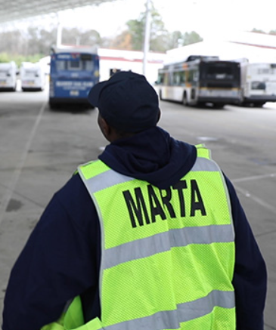
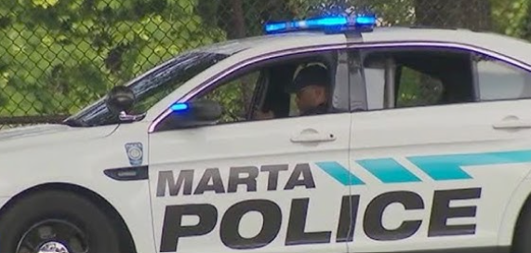
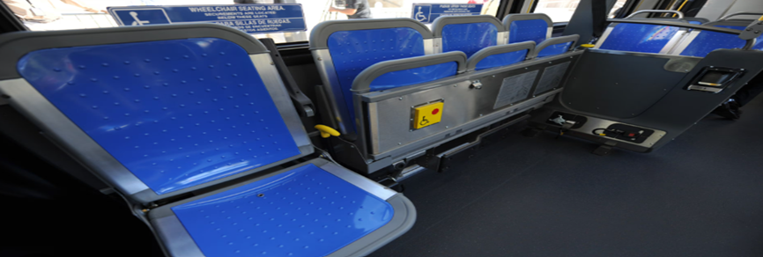
SAFETY
Beefing up staff at each platform will help with passenger flow
One person at a time on the escalator
Staff notifying customers when train is at capacity
Conduct safety check on all station escalators and elevators prior to the event
Notes:
Viola

Slide 7
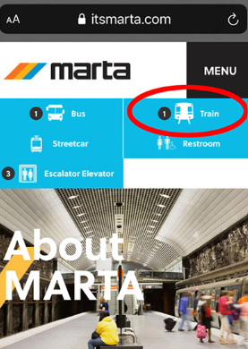


COMMUNICATION
Staff holding “Ask me a question” sign so people know where to go if they are lost
More accurate train arrival time notices during special/increased frequencies
Increased wayfinding at event location
More verbal cues on the train throughout the system specifically for the event
Notes:
Erin

Slide 8
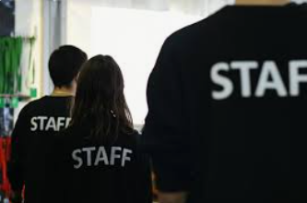
STAFFING
MARTA staff on the platform by each door of the train allowing people on and off the train until at capacity
MARTA staff at the fare gates to encourage tap to pay for faster flow
MARTA staff at each escalator allowing one person at a time
Additional staff on the platform
Notes:
Kirk

Slide 9
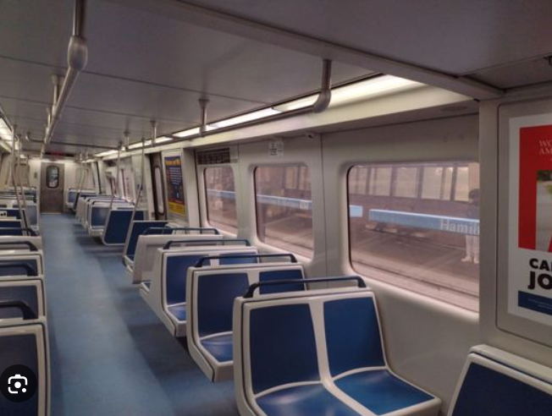
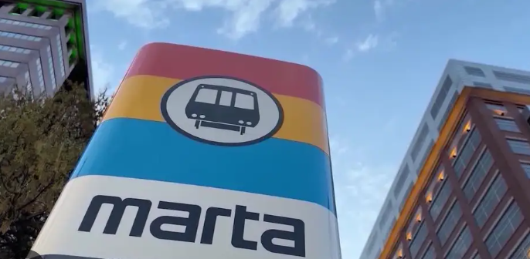
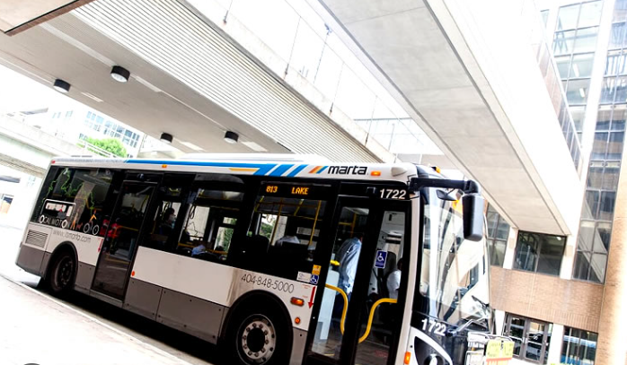
OVERALL CUSTOMER EXPERIENCE (CX)
Customers feel safe while in the station
QR codes for CX Survey
Efficient & Effective
Customers feel supported by MARTA
Handing out MARTA swag
Notes:
Malachi

Slide 10
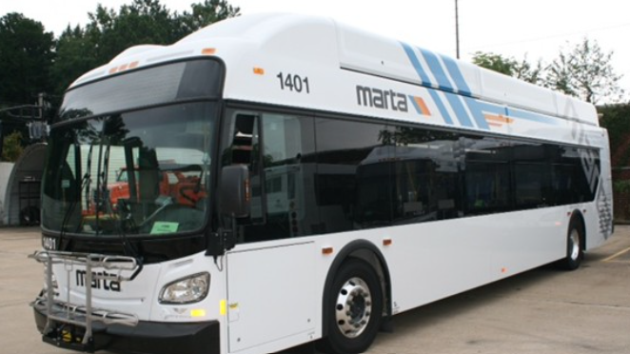
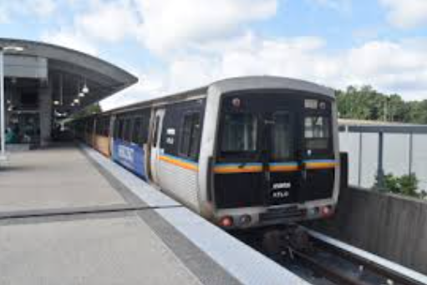
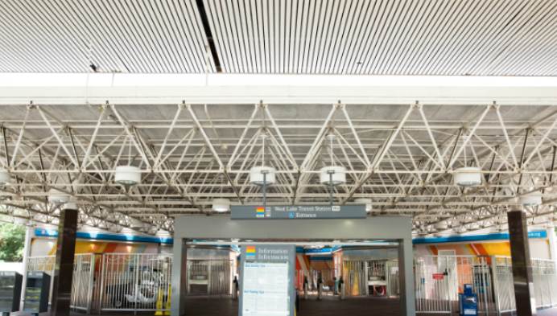
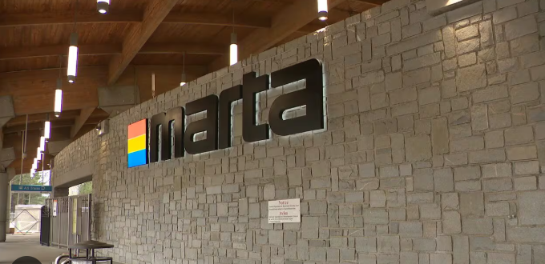
SUMMARY
Using barricades to create directional flow of passengers
Conduct safety checks on all escalators and elevators
Increased wayfinding at event and verbal cues on the train
Strategically placing MARTA staff to guide customers safely
Customers feel safe and are transported effective and efficiently

Slide 11

QUESTIONS

